Slide 1


University of San Carlos Department of Physics
Micromechanical properties of cancer cells (SaOs-2 Osteosarcoma Cell Line) in reconstituted fibrin gel using video microscopy
Kristian Angeli Pajanonot and Rommel Bacabac, Ph.D.
Medical Biophysics Group
Department of Physics, University of San Carlos
Nasipit, Talamban, Cebu City, Philippines 6000

Slide 2

CANCER
A class of diseases characterized by out-of-control cell growth and spread of cells. Cancer is one of the leading causes of morbidity and mortality worldwide, with approximately 14 million new cases in 2012. Cancer is responsible for 8.8 million deaths in 2015. Approximately 70% of deaths from cancer occur in low- and middle-income countries.
World Health Organization
Notes:
Cancer is the uncontrolled growth and spread of cells. Cancer is one of the leading causes of morbidity and mortality worldwide. Cancer is responsible for 8.8 million deaths in 2015.

Slide 3
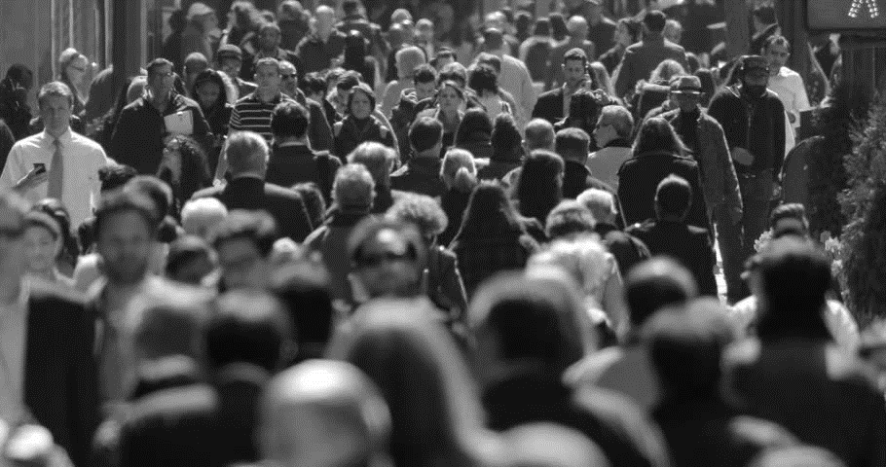
Cancer remains to be
a big problem until today
Notes:
Up to this day, cancer remains to be a big problem

Slide 4
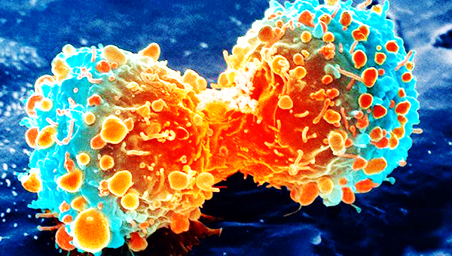
WHY and how
DO CANCER CELLs SPREAD?
https://www.cancer.gov/about-cancer/understanding/what-is-cancer

Slide 5
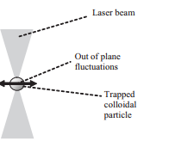

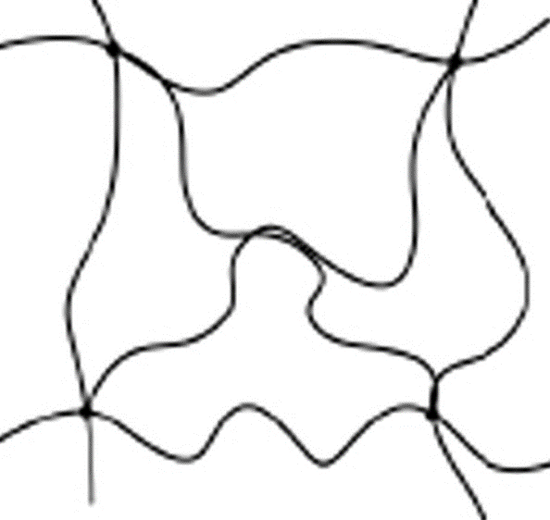
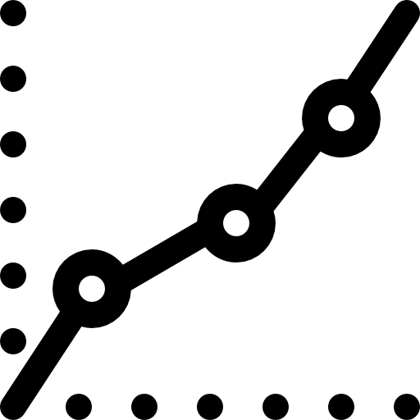
Outline:
INTRODUCTION
THEORY
METHODOLOGY
RESULTS
1
2
3
4

Slide 6
Outline:
INTRODUCTION
THEORY
METHODOLOGY
RESULTS
1
2
3
4

Slide 7
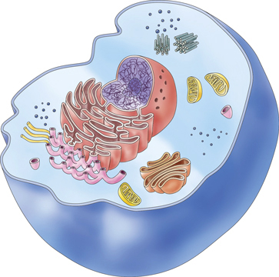
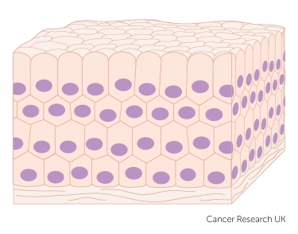
INTRODUCTION
cell
TISSUE
basic building blocks
Cells + Extracellular matrix
http://thescienceclassroom.org
Figure 2: Tissue
Figure 1: Cell
Notes:
The cell is the structural unit of life. Human cells grow and divide to form new cells as the body needs them. A tissue is a group of cells and its extracellular matrix. when cells grow old or become damaged, they die, and new cells take their place

Slide 8
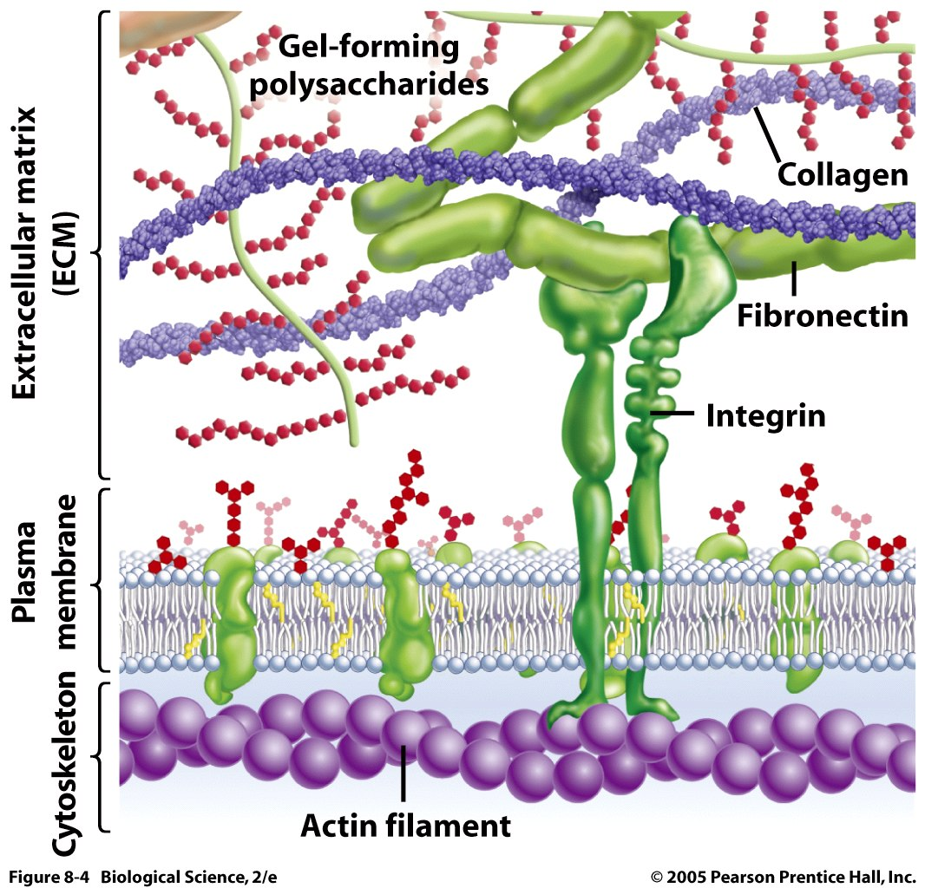
INTRODUCTION
Cell: cytoskeleton and Extracellular Matrix
Cytoskeleton is an interconnected network of three different filament types that play in the over-all mechanical behavior of the cell.
Extracellular Matrix (ECM) provides an anchoring support to cells and helps to bind cells together to form tissues
http://thescienceclassroom.org
Figure 5: Cytoskeleton and Extracellular Matrix
The transmembrane integrin receptors of cells bind extracellular matrix (ECM) proteins thus allowing cells to spread; thereby the cytoskeleton inside the cells is physically connected to the ECM.
Jansen, K., Bacabac, R., Piechocka, I., & Koenderink, G. (2013). Cells actively stiffen fibrin networks by generating contractile stress. Biophysical Journal, 105, 2240-2251.
Piechocka, I. (2012). Biopolymers: from structural hierarchy to nonlinear rheology.
.
Notes:
The mechanical behavior of animal cells is controlled by the cytoskeleton, responsible for the over-all mechanical behavior of the cell. The cell is highly affected by the extracellular matrix, its surrounding environment. It helps bind cells together to form tissues. Now, the integrin receptors of cells found in the cytoskeleton binds with the ECM. Thus allowing cells to spread and therefore the cytoskeleton becomes physically connected to the ecm.

Slide 9
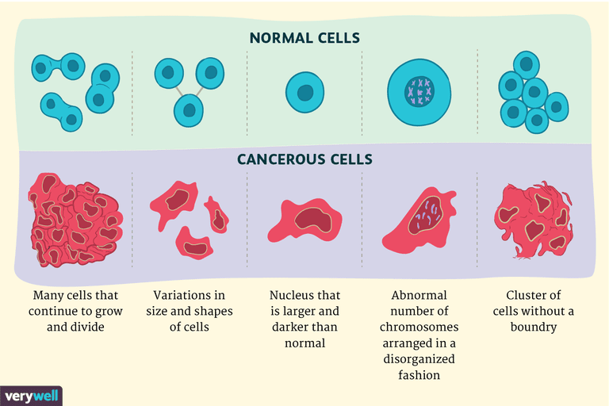
INTRODUCTION
How do Cancer cells differ from Normal Cells?
Cancer cells grow beyond their usual boundaries and divide in an uncontrolled manner, rather than responding appropriately to the signals that control normal cell behavior, thus invading normal tissues and organs and eventually spreading to distant parts of the body.
https://www.verywell.com/cancer-cells-vs-normal-cells-2248794
Figure 3: Cancer cells vs. Normal cells
Cooper, G. (2000). The Cell: A Molecular Approach. 2nd edition. Sunderland (MA): Sinauer Associates.
Notes:
Cancer cells differ from normal cells in a lot of ways as shown in the image. Cancer cells are deaf to the environment, because of that, its hard for them to respond to the signals being thrown to them, thus they grow beyond their usual boundaries and invade tissues and organs and eventually spread to other parts of the body

Slide 10
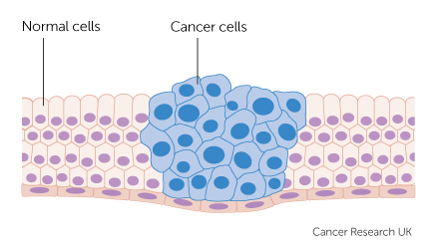
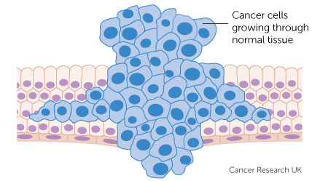
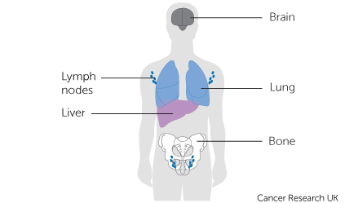
INTRODUCTION
MALIGNANT Tumor
INVASIVE AND CAN SPREAD
Cells+ecm
Figure 4: Cancer Metastasis
Metastasis – spread of cancer cells to other parts of the body and grows, invading and destroying other healthy tissues
Metastatic potential - the onset of active motility enabling tumor cells to migrate onto other sites of the body
(National Cancer Institute, 2015)
.
Notes:
Cancer cells continue to grow and divide to create more cells, eventually forming a tumor. Tumor is the combination of cells and extracellular matrix.This is an abnormal mass of tissue. There are two types of tumors, benign or malignant. One major characteristic that differentiate malignant tumors from benign ones are their invasiveness and spread Malignant tumors are also referred to as metastatic tumors. Metastasis involves the spread of cancer cells from the primary tumor to surrounding tissues and to distant organs. Majority of cancer-related deaths is caused by cancer metastases which accounts for about 90% of human cancer deaths [4]. Metastatic potential is defined as the onset of active motility enabling tumor cells to migrate onto other sites of the body. Cells that are able to spread and invade distant parts of the body are said to have the potential to metastasize.

Slide 11
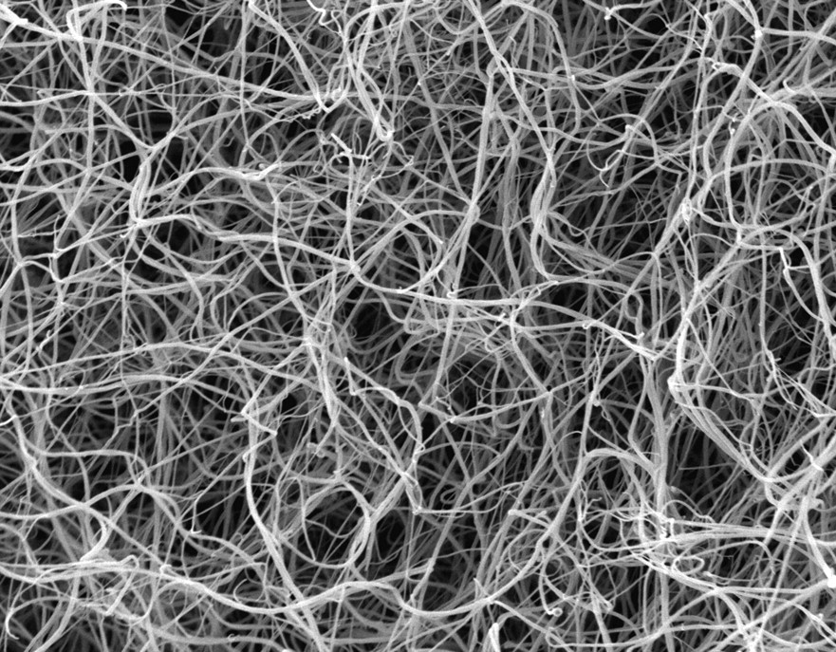
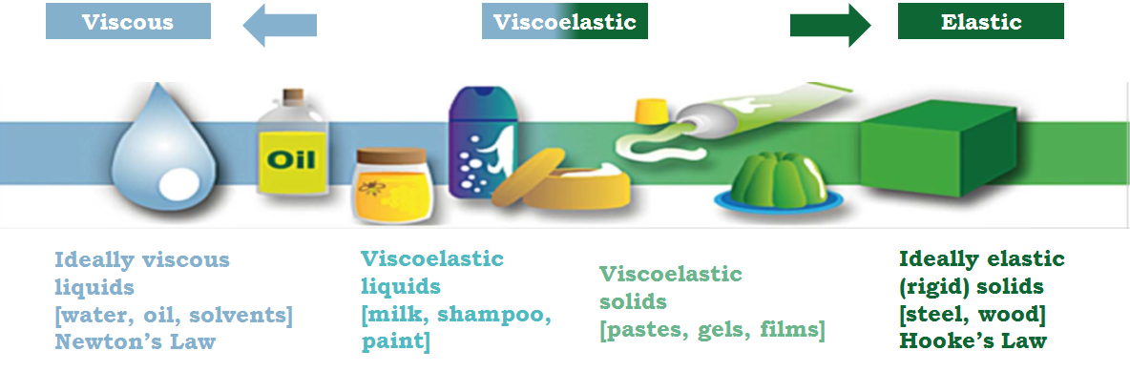
INTRODUCTION
Fibrin
FIBRIN GEL: A VISCOELASTIC MATERIAL
Figure 7: Scanning electron micrograph of 1 mg/L human fibrinogen polymerized by 1 U/mL thrombin Fibrin (Janmey, 2008)
https://www.quora.com/What-is-the-relevance-of-Hookes-law-and-Newtons-law-in-the-rheology-of-polymers
Figure 6: Viscoelasticity
Soft materials are viscoelastic
Protein responsible for blood clot
Fibrin gels: combination of Fibrinogen and Thrombin
Janmey, P. A., Winer, J. P., & Weisel, J. W. (2008). Fibrin gels and their clinical and. J. R. Soc. Interface, 1–10
Piechocka, I. K., Bacabac, R. G., Potters, M., MacKintosh, F. C., & Koenderink, G. H. (2010). Structural Hierarchy Governs Fibrin Gel Mechanics. Biophysical Journal, 2281–2289.
Notes:
Materials are characterized based on their properties. A shown in figure 6, materials on your right as classified as elastic. When a certain material experiences deformation because of an external force, internal forces that oppose the deformation and goes back to its original state when the deformation is no longer applied, hence the term elastic. Contrary to simple solids that store energy, simple liquids dissipate energy through flow. When the force is removed, simple liquids do not return to their original state. Biological cells and tissues fall under the category of “soft matter” for they are composed of mainly soft materials, such as biopolymers, gels . Soft materials are neither simple solids nor simple liquids, but exhibit both elastic and viscous properties and are therefore called viscoelastic.
Fibrin is a viscoelastic material that plays a critical role in hemostasis which stop bleeding (Janmey, Winer, & Weisel, 2008). Upon a vascular injury, fibrin polymerizes and forms a fibrous gel that can resist the forces exerted by blood flow. An addition of thrombin to a solution of fibrinogen causes an immediate polymerization of fibrin that serves as the structural framework of blood clot resulting from damages to normal tissue (Piechocka, Bacabac, Potters, MacKintosh, & Koenderink, 2010).

Slide 12
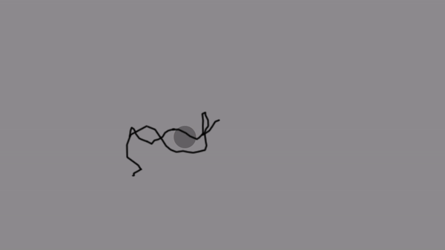
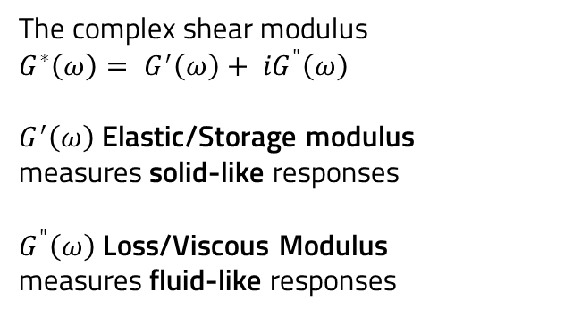
VISCOELASTICITY
rheology
study of flow and deformation of materials under applied forces
The complex shear modulus
$G^{∗}\left(ω\right)= G^{′}\left(ω\right)+ {iG}^{"}\left(ω\right)$
$G^{′}\left(ω\right)$ Elastic/Storage modulus
measures solid-like responses
$G^{"}\left(ω\right)$ Loss/Viscous Modulus
measures fluid-like responses
Eq. 1
https://www.quora.com/What-is-the-relevance-of-Hookes-law-and-Newtons-law-in-the-rheology-of-polymers
Figure 6: Viscoelasticity
Fibrin and tissues are viscoelastic materials
MICRORHEOLOGY
Advantages over Macrorheology:
*limited amount of sample is needed
*local viscoelastic response is measured by observing the motion of the probe particle
*viscoelastic properties can be measured over a wide frequency range
Figure 8: Passive Microrheology
Vincent, J. (1982). Structural Biomaterials. Palgrave Macmillan UK.
Mizuno, D., Head, D., MacKintosh, F., & Schmidt, C. (2008). Active and Passive Microrheology in Equilibrium and Nonequilibrium Systems. Macromolecules, 7194–7202
Notes:
As discussed previously, fibrin and tissue then are considered as viscoelastic materials. How fibrin and tissues respond to force is determined by its viscoelastic properties. To characterize this, we look into rheology, the study of deformation and flow of a material when force is applied. Rheological measurements reveal both soliq and liquid like responses. This is quantified through the complex shear modulus, the summation of G’ and G”. G’ shows how elastic or solid the material is and G” shows how viscous or fluid the material is. To characterize this rheological response is to measure shear modulus as a function of frequency. There are two types of rheology, we have microrheology and macrorheology. This study focuses on microrheology. Microrheology is a term for a number of techniques designed to probe small samples and to measure local viscous and elastic properties of materials by observing the motion of micrometer-sized probe particles.
There are two types of microrheology, we have passive microrheology wherein, the probe particle monitored is free (Brownian motion), or active microrheology wherein the probe is driven by an externally imposed force.

Slide 13
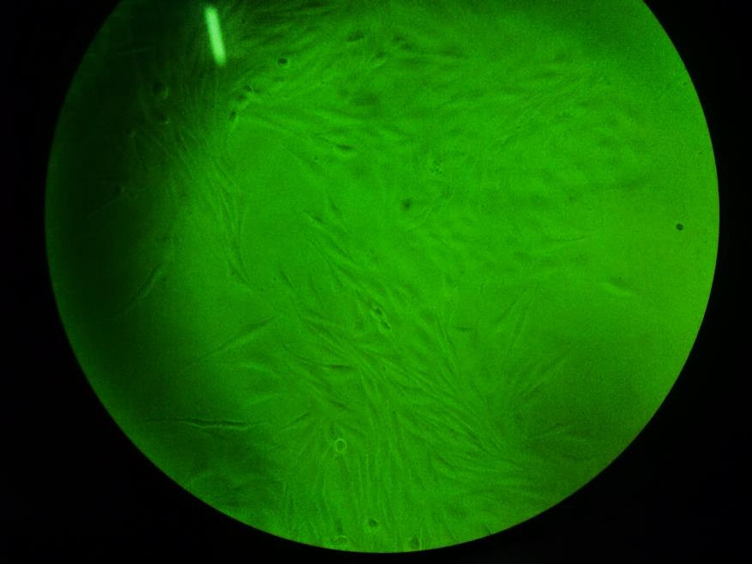
Fibrin as substrate
INTRODUCTION
Fibrin
SaOs-2 Osteosarcoma Cell Line
J. Ichickawa et al., 2012
Fibrin is an ideal matrix for tumor growth
+
V. Constantini et al., 1992
Fibrin enhances tumor integrity by providing a framework for the growth of tumor cells
Figure 9: Fibrin (Janmey, 2008)
Figure 10: SaOs-2 cells,10 days after cell culture
J. Ichickawa, H. Cole, R. Magnussen, N. Mignemi, M. Butler, G. Holt, L. O'Rear, M. Yuasa, B. Pabla, H. Haro, J. Cates, H. Hamm, H. Schwartz and J. Schoenecker, "Thrombin induces osteosarcoma growth, a function inhibited by low molecular weight heparin in vitro and in vivo: procoagulant nature of osteosarcoma.," Cancer, pp. 2494-506, 2012.
V. Constantini and L. R. Zacharski, "The role of fibrin in tumor metastasis," Cancer and Metastasis Review, pp. 283-290, 1992.
Notes:
Cells sense their mechanical environment and the substrate on which a cell grows can influence the behavior of the cell. In this study, I am trying to create a biomimetic tissue model wherein SaOs-2 cells, a primary malignant bone tumor will be embedded in fibrin, acting as the ecm. Fibrin has been linked to cancer biology for a long time. According to and Constantini, fibrin provides a framework for tumor growth thus is an ideal matrix. Since fibrin creates an impression on the behavior of the cells, the mechanical properties of fibrin should be taken into consideration in studying the cell.

Slide 14
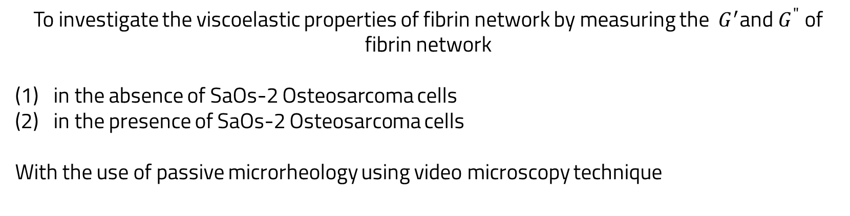
Objectives of the study:
INTRODUCTION
To investigate the viscoelastic properties of fibrin network by measuring the $G^{′}$and $G^{"}$ of fibrin network
in the absence of SaOs-2 Osteosarcoma cells
in the presence of SaOs-2 Osteosarcoma cells
With the use of passive microrheology using video microscopy technique

Slide 15
Outline:
INTRODUCTION
THEORY
METHODOLOGY
RESULTS
1
2
3
4

Slide 16
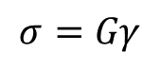
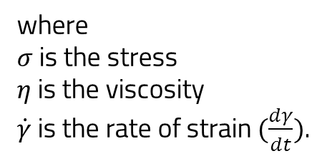
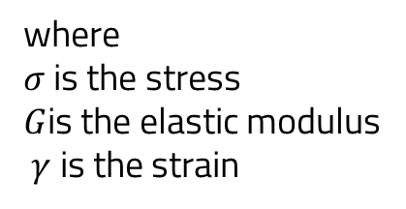
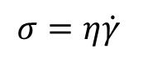
THEORY
VISCOELASTICITY
Simple solids store energy
Hookean Solid:
$$σ=Gγ$$
Eq. 2
where
$σ$ is the stress
$G$is the elastic modulus
$γ$ is the strain
Simple liquids dissipate energy through viscous flow
Newtonian fluid:
$$σ=η\dot{γ}$$
Eq. 3
where
$σ$ is the stress
$η$ is the viscosity
$\dot{γ}$ is the rate of strain $(\frac{dγ}{dt})$.
Viscoelastic materials exhibit both viscous and elastic properties
Notes:
Simple solids store energy and provide a spring-like or elastic response, described by Hooke’s law where stress is equal to the elastic modulus times the strain. Whereas simple liquids dissipate energy through viscous flow described by Newton’s law where the stress is equal to viscosity times strain rate. Materials that exhibit both viscous and elastic are called viscoelastic.

Slide 17
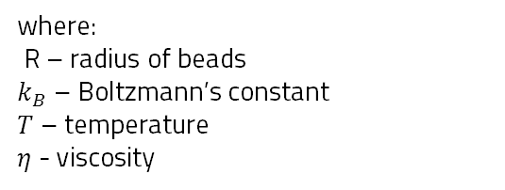
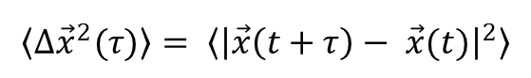
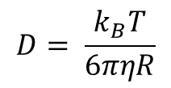
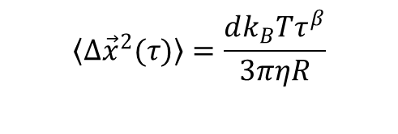
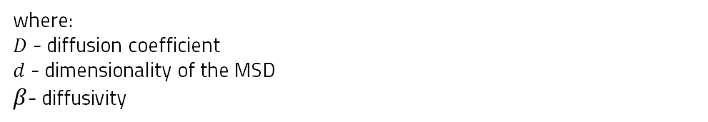
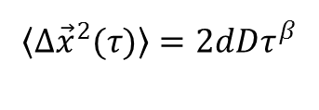
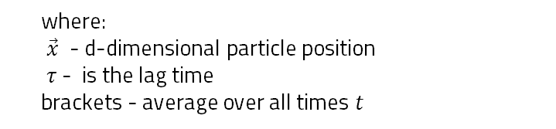
THEORY
PASSIVE MICRORHEOLOGY | VIDEO MICROSCOPY
Stokes-Einstein relation describes the diffusion rate for any particle in the solution
The diffusion coefficient is related to the Mean Squared Displacement (MSD)
$$D= \frac{k_{B}T}{6πηR}$$
$$〈∆{\vec{x}}^{2}(τ)〉=2dDτ^{β}$$
Eq. 6
Eq. 4
where:
R – radius of beads
$k_{B}$ – Boltzmann’s constant
$T$ – temperature
$η$ - viscosity
where:
$D$ - diffusion coefficient
$d$ - dimensionality of the MSD
$β$- diffusivity
The motion of the particle:
mean-squared displacement (MSD)
Eq. 5
Mean Squared Displacement (MSD) equation:
$$〈∆{\vec{x}}^{2}(τ)〉= 〈{\left|\vec{x}\left(t+τ\right)− \vec{x}(t)\right|}^{2}〉$$
$$〈∆{\vec{x}}^{2}(τ)〉=\frac{dk_{B}Tτ^{β}}{3πηR}$$
Eq. 7
where:
$\vec{x}$ - d-dimensional particle position
$τ$ - is the lag time
brackets - average over all times $t$
Notes:
As mentioned earlier, in passive microrheology, the thermal fluctuations or Brownian motion in the network are tracked on the micrometer scale using probe.
For passive microrheology using video microscopy, probe particles are embedded in the sample.
How the particle diffuses into the sample is described by the stokes Einstein relation. Which depends on the temperature of the solution and the viscous drag the solution imparts on the particle.
Diffusion relates directly to the fundamental motion of particles. The determination of the MSD is very important in any complex process because of its relation to diffusion which can be quantified. The diffusion coefficient, $D$, of the particles in Brownian motion is related to the Mean Squared Displacement (MSD) through Equation 5
The dynamics of particle motions are revealed in the time-dependent position correlation function of individual tracers known as the mean-squared displacement as shown in equation 3. The diffusion coefficient, D, of the Brownian particles is obtained from the diffusion equation as shown in eq.4. Einstein described the diffusion coefficient in the general form where kbt refers to the thermal energy and theta? Defines the stokes drag interaction between a solvent with viscosity n and the diffusing particle’s size and shape. The specific diffusion coefficient for a sphere with a radius R is shown in equation 6.

Slide 18
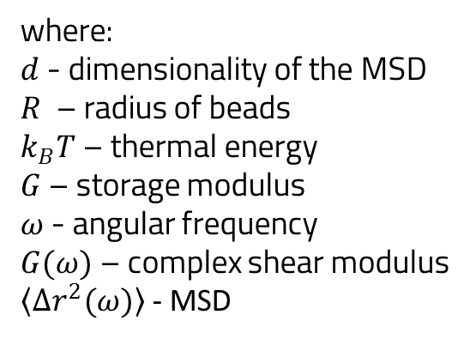
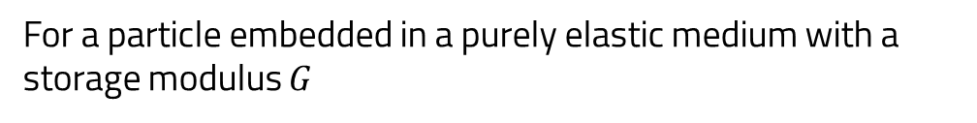
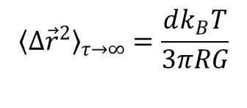
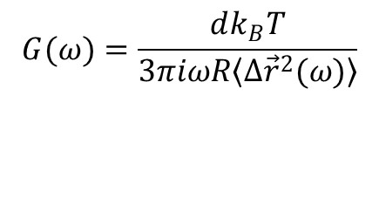
THEORY
PASSIVE MICRORHEOLOGY | VIDEO MICROSCOPY
For a particle embedded in a purely elastic medium with a storage modulus $G$
where:
$d$ - dimensionality of the MSD
$R$ – radius of beads
$k_{B}T$ – thermal energy
$G$ – storage modulus
$ω$ - angular frequency
$G(ω)$ – complex shear modulus
$〈∆r^{2}(ω)〉$ - MSD
$${〈∆{\vec{r}}^{2}〉}_{τ→∞}=\frac{dk_{B}T}{3πRG}$$
Eq. 8
Using the Generalized Stokes-Einstein relation to obtain the complex shear modulus
$$G(ω)=\frac{dk_{B}T}{3πiωR〈∆{\vec{r}}^{2}(ω)〉}$$
Eq. 9
Notes:
If the same particle is embedded in a purely elastic medium with a storage modulus $G$, there will be a maximum to the displacement $∆r$, occurring when the thermal energy $k_{B}T$ of the particle equals the elastic energy associated with the deformed network. In terms of the MSD this means that a plateau is reached for long lag times:
(9)
Most materials, however, exhibit more complex behavior with a frequency dependent viscoelastic response that has both viscous and elastic components. These materials are characterized by the complex modulus $G^{∗}\left(ω\right)= G^{′}\left(ω\right)+ {iG}^{"}\left(ω\right)$. A generalized Stokes-Einstein relation (GSER) is used in this case to obtain a frequency dependent MSD (Mason & Weitz, 1995):

Slide 19
Outline:
INTRODUCTION
THEORY
METHODOLOGY
RESULTS
1
2
3
4

Slide 20
METHODOLOGY
Sample Preparation
01
Fibrin Gel Preparation
02
Cancer-seeded Gel Preparation
Experimental set-up
03
Video Microscopy

Slide 21
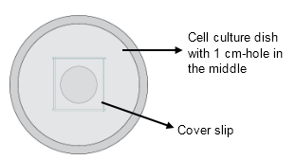
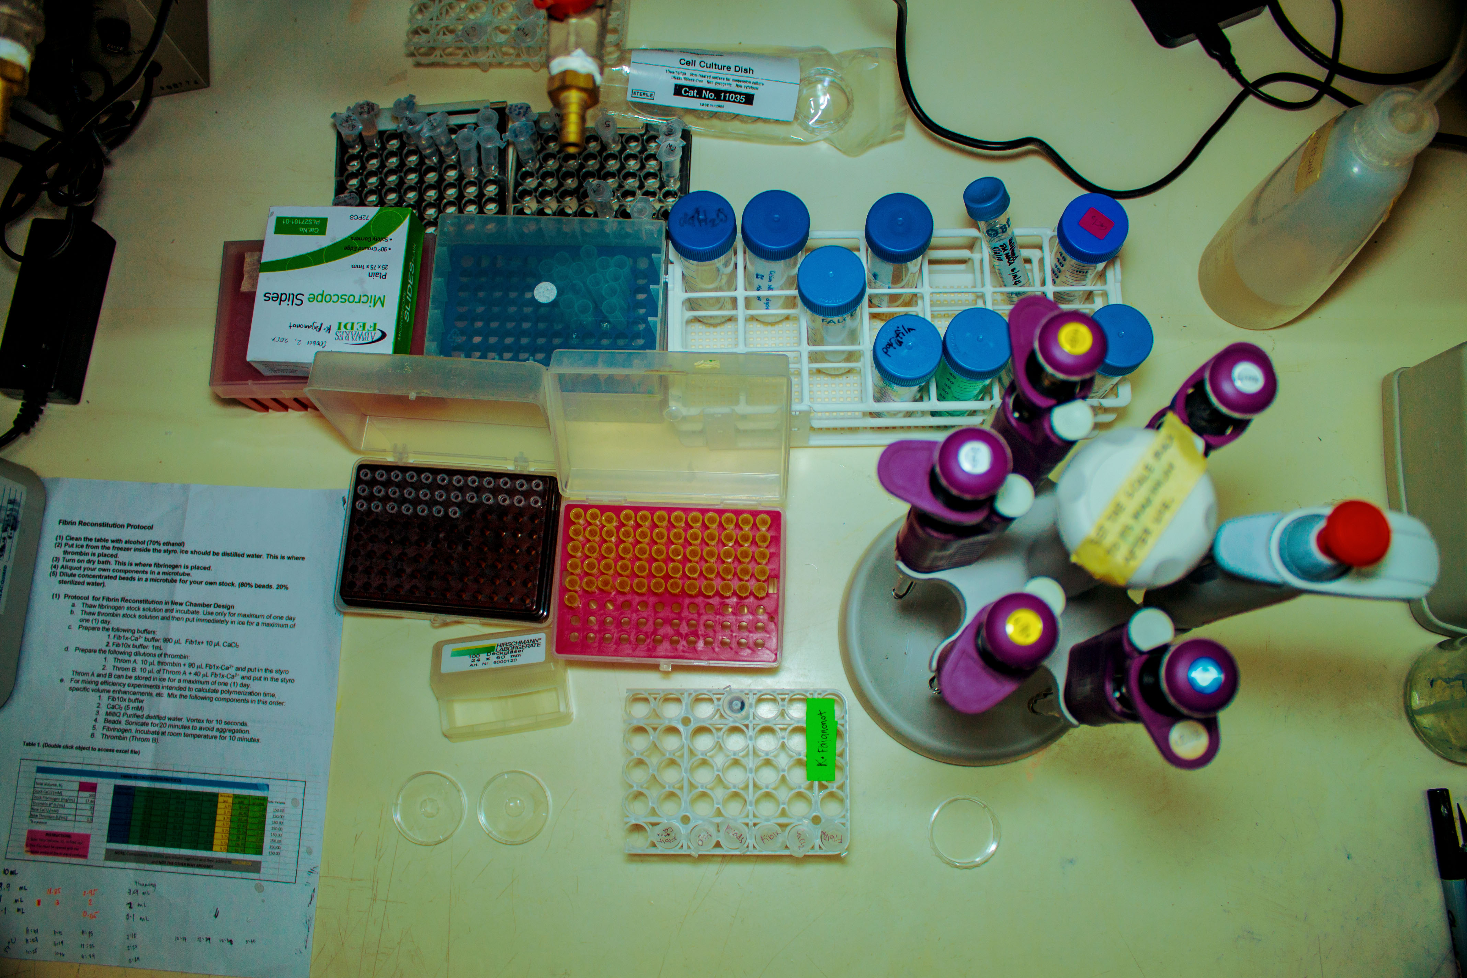
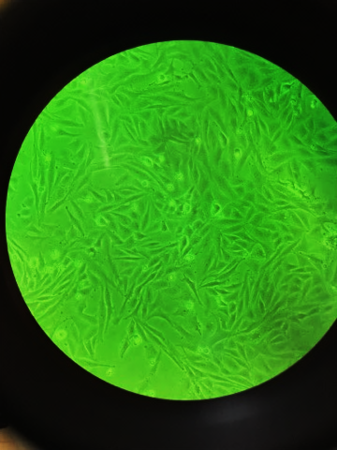
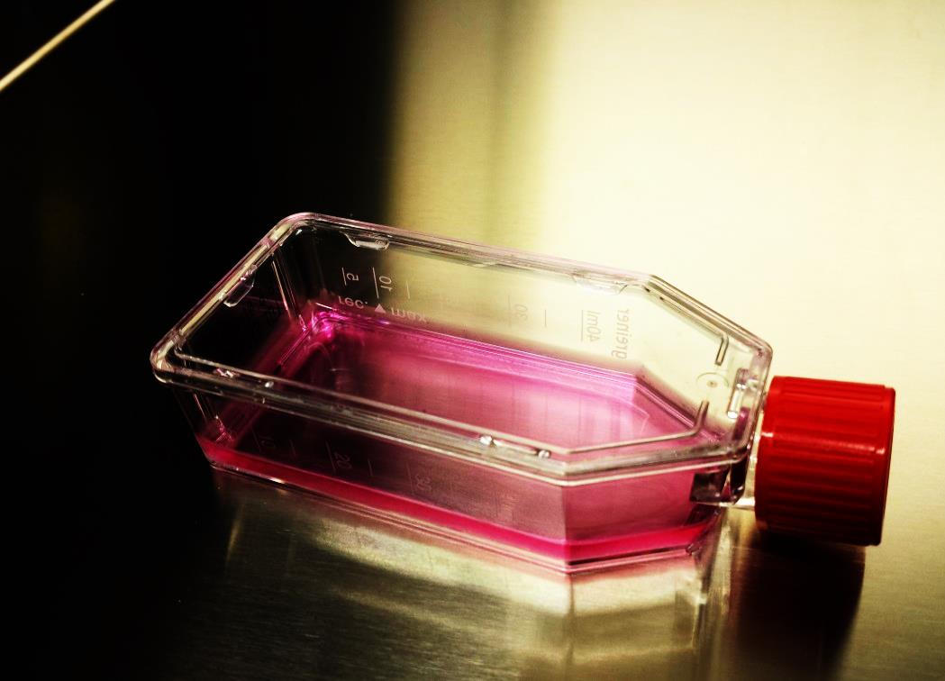
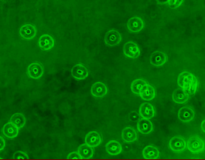
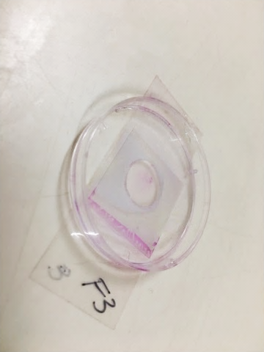
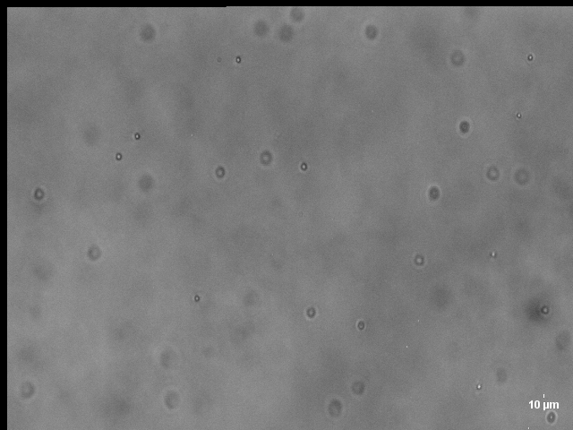
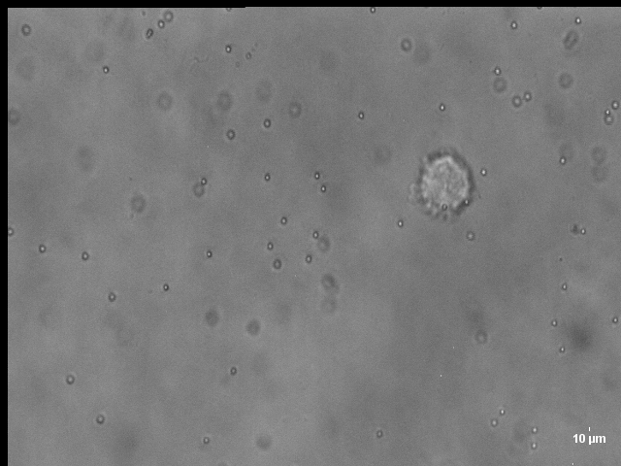

Sample Preparation
METHODOLOGY
Fig.11 Customized Chamber
Fibrin Gel Preparation
Cancer-seeded gel Preparation
Fig. 15 Suspended SaOs-2 cells
Detach by trypsinization
Fig. 12 Fibrin Gel Preparation
Fig. 14 Cell culture
Cells are added to fibrin
SaOs-2 cell
beads
Fig. 16 Cancer-Seeded Fibrin Gel chamber
100 $μ$m
100 $μ$m
Fig. 13 Fibrin Gel
Fig. 17 Cancer-seeded Fibrin Gel
Notes:
1.0 mg/ml Fibrinogen 3 hours after the addition of thrombin
). Fibrinogen solutions are then mixed in a fibrin assembly buffer. Fibrinogen network with concentration of 1.0 mg/mL, 2.0 mg/mL, and 3.0 mg/mL are to be formed by mixing at room temperature, 1.0 µm diameter polystyrene beads (Phosphorex, Hopkinton, MA, USA) are embedded in the samples to probe the rheological properties of the material. To initialize polymerization, 0.5 IU/mL of human α-thrombin
cancer cells are mixed into the sample with the volume of water decreased to compensate for the addition of cancer cells

Slide 22
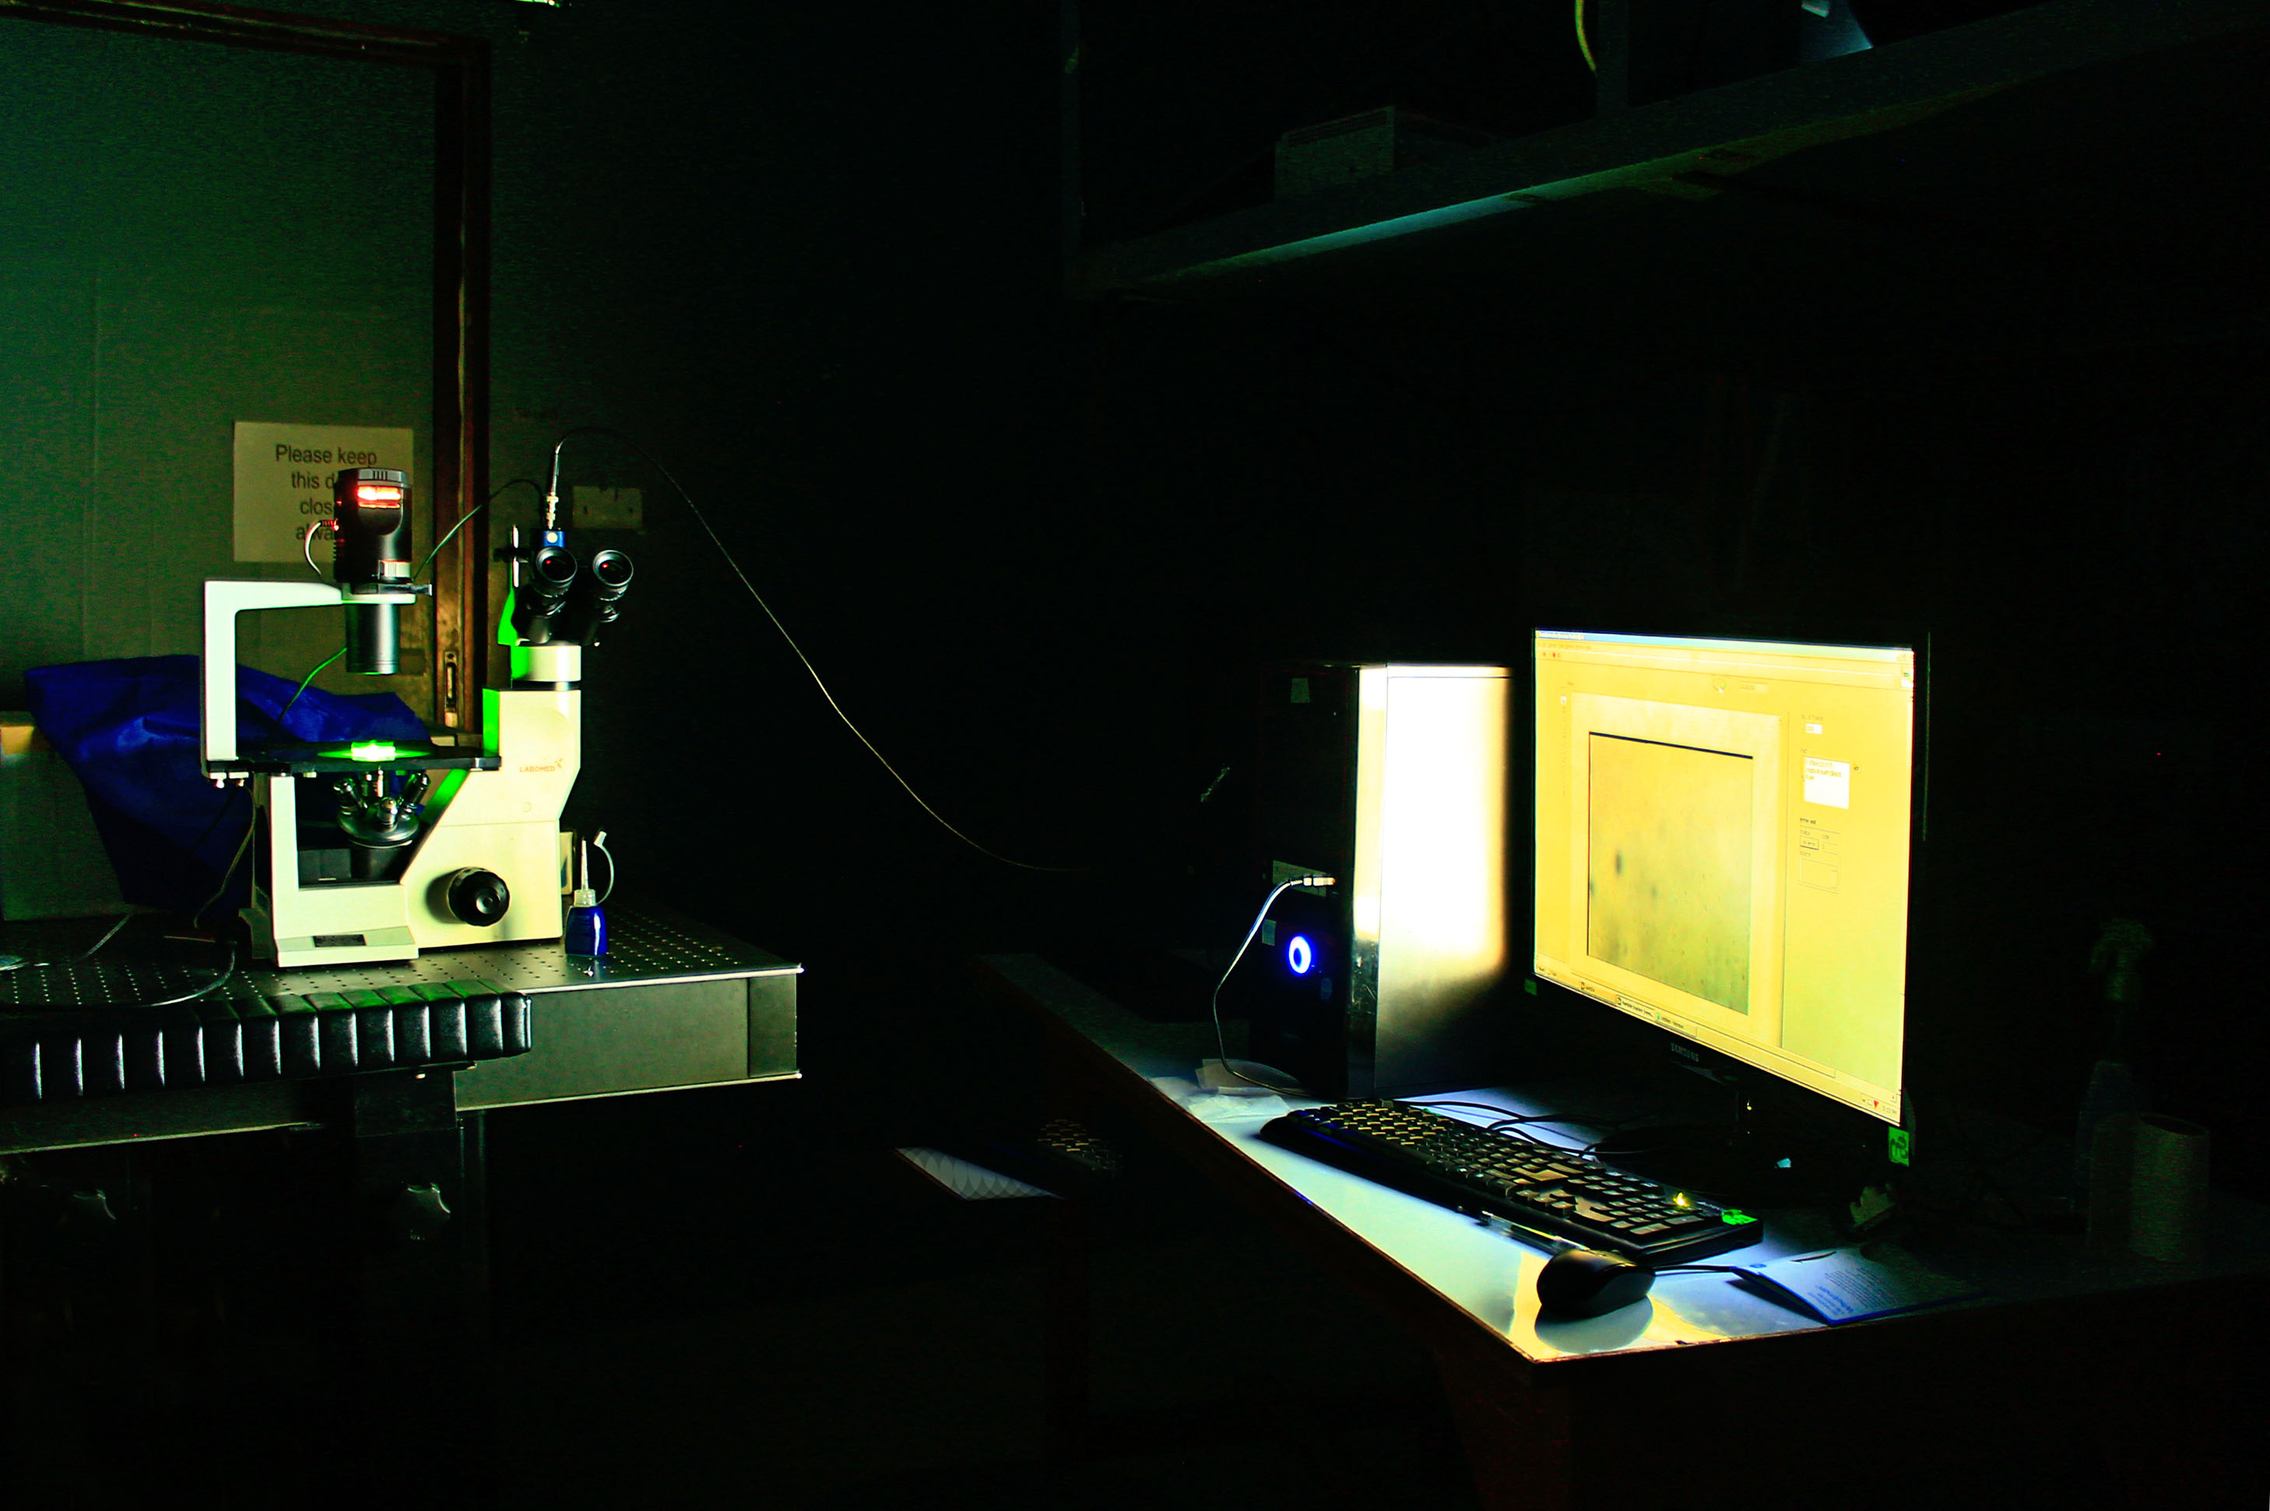
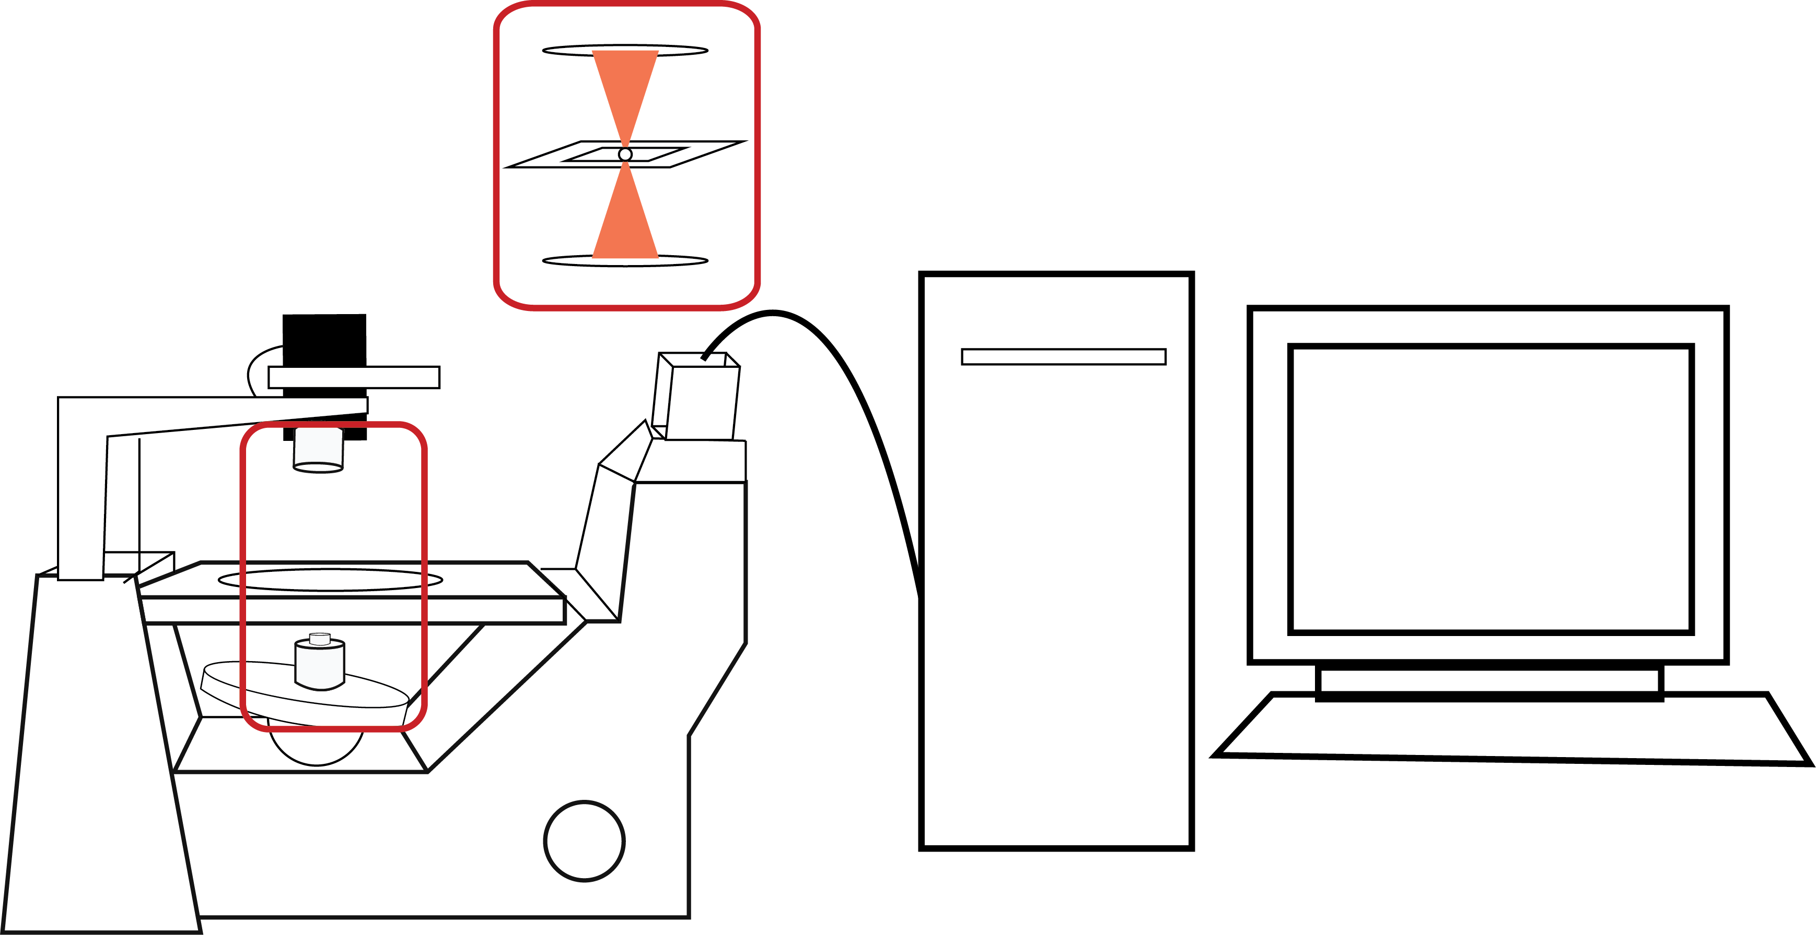
Experimental set-up
METHODOLOGY
Figure 19. Medical Biophysics Group Video Microscopy Set-up
Camera
Microscope
Computer
Figure 18: Experimental Set-up of Video Microscopy
Notes:
The samples are viewed under a bright field microscope (TCM 400, Labomed, USA) with 60x oil immersion objective (Carl Zeiss Microscopy, Germany). Using the LabView program (Particle Tracker.vi), images will be captured at a rate of 25 frames per second using an analog charge coupled device (CCD) camera (WAT-902H, Watec, Japan) mounted on the side port of the microscope. For every trial, 3,000 images will be captured and saved in sequence with a .TIFF format for processing and tracking of probe particles.

Slide 23
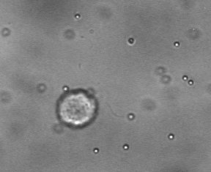
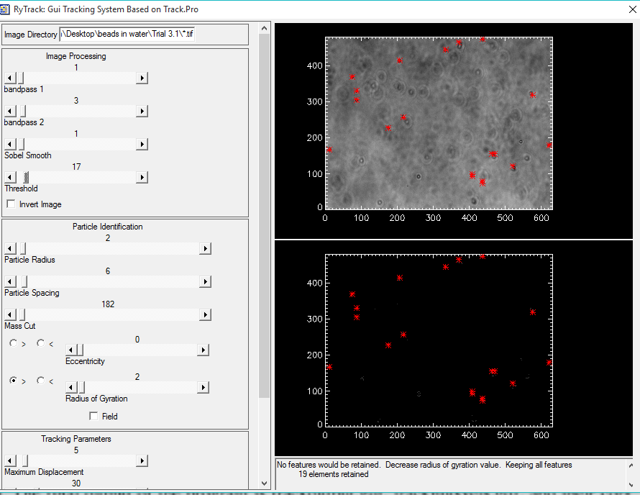
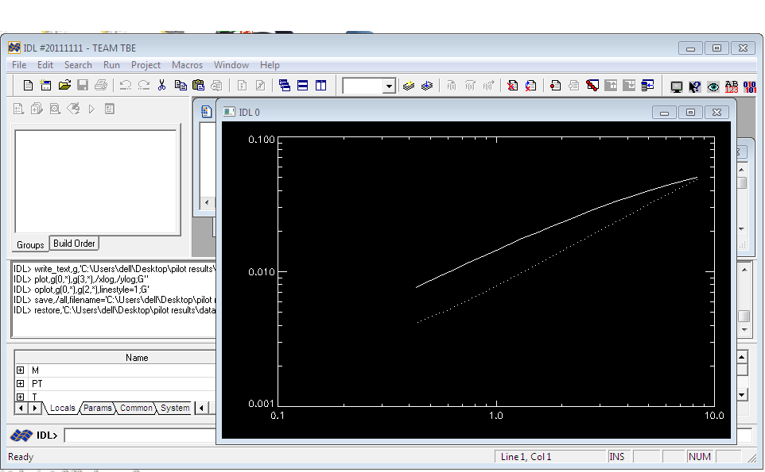
procedure
METHODOLOGY
Camera
Microscope
Computer
Figure 19: Experimental Set-up of Video Microscopy
Pre-track:
Image Acquisition
Track:
Particle Identification and Particle tracking
Post – Track:
Calculation of Complex shear modulus in IDL
Figure 20: Fibrin Gel with cells
Figure 21: Rytrack Program
Figure 22: IDL Program
Notes:
In the pre track, a sequence of images of embedded probes in the sample is obtained using the microscope system connected to a computer. In the track stage, data on the particle trajectories are extracted from the sequenced images using rytrack program. Using a software written in IDL, the trajectory data is used to obtain the complex shear modulus.

Slide 24
Outline:
INTRODUCTION
THEORY
METHODOLOGY
RESULTS
1
2
3
4

Slide 25
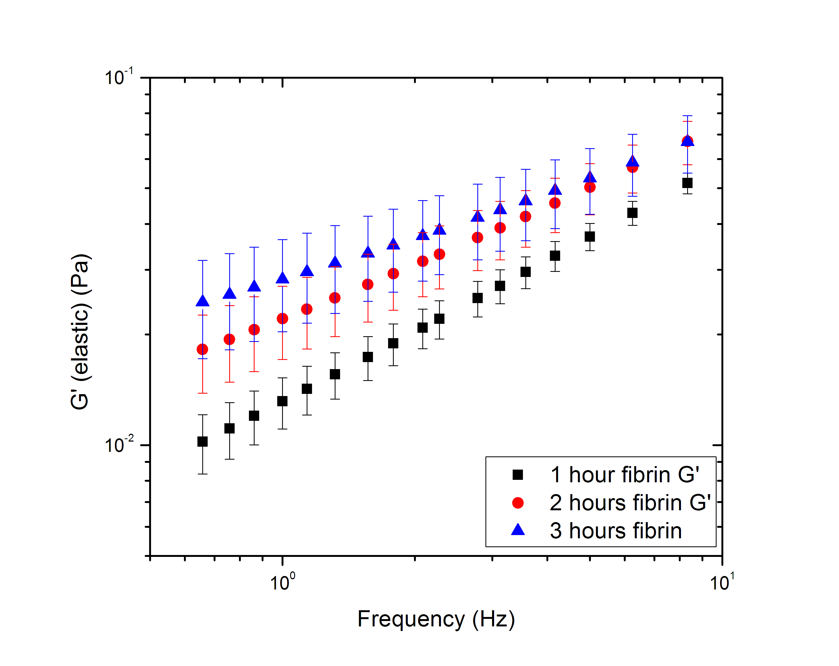
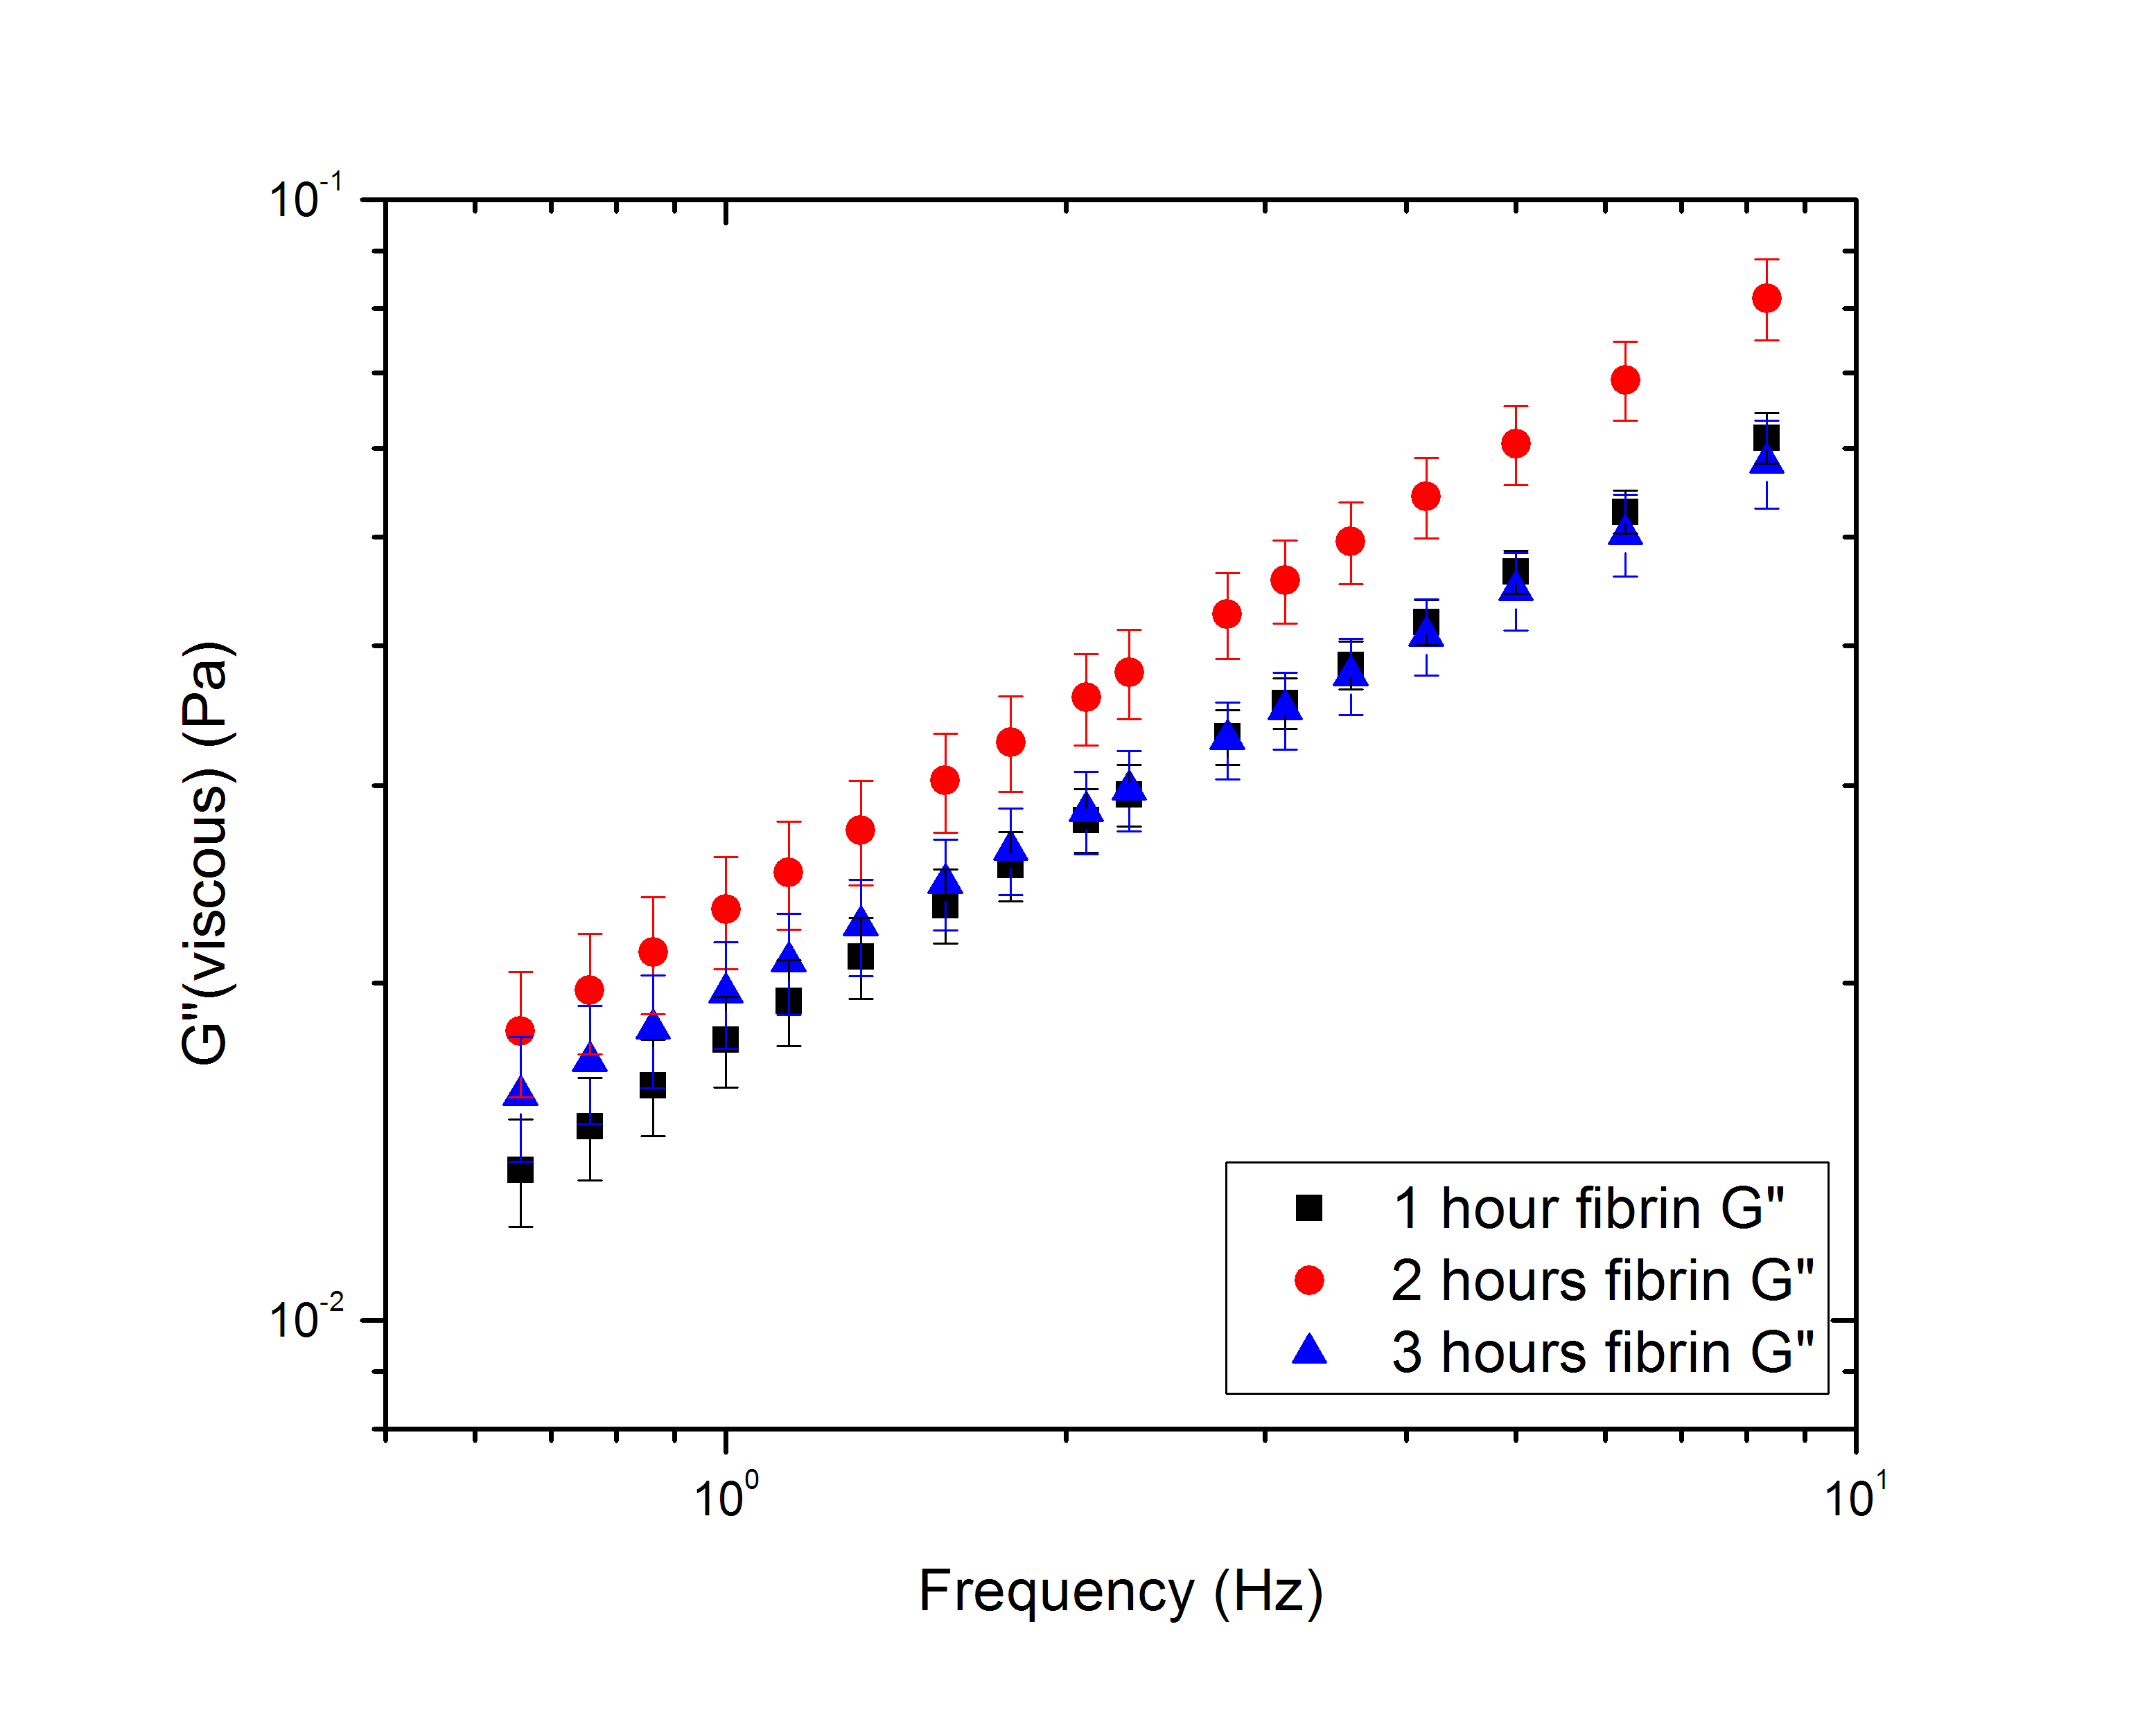
Microrheology of Fibrin Gel using Video Microscopy
RESULTS
A
B
Figure 23. The elastic moduli G’ (A) and viscous moduli G” (B) of fibrin gel at 1 hour, 2 hours, and 3 hours of observation
Notes:
Using passive microrheology: video microscopy technique, the elastic and viscous moduli of fibrin for 1 mg/mL concentration are shown as a function of frequency. Polystyrene beads of 1 $μ$m in diameter were embedded on the sample solution to serve as the probe particles. The elastic modulus started to increase as it is observed in longer duration.

Slide 26
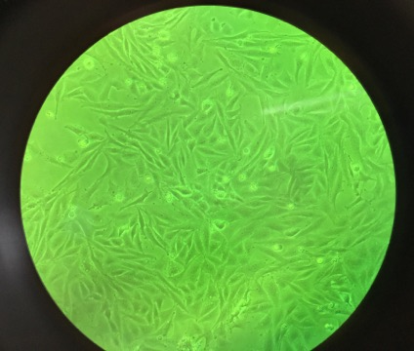
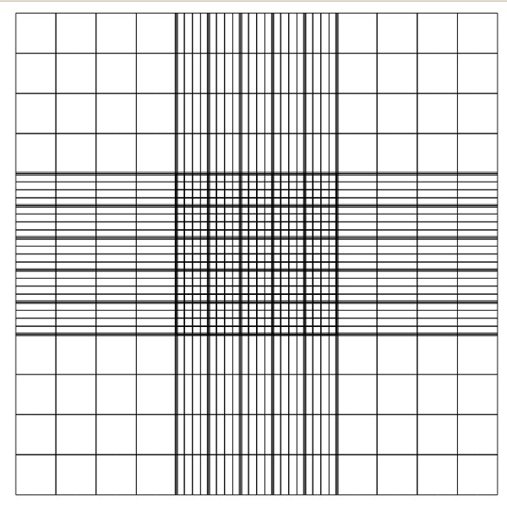

Microrheology of Cancer-seeded Fibrin Gel
RESULTS
41
59
Cell density of 500 cells/$μ$L
78
50
Figure 24: Osteosarcoma cells reaching confluency after 3 days from subculture
Figure 25: Number of cells acquired in each 1 mm² of the counting grid of the hemocytometer
Notes:
On the third day from subculture, the desired confluency of SaOs-2 cells is acquired as shown in Figure 8. These adherent cells are detached and collected by the addition of trypsin solution. Using the hemocytometer, the number of cells obtained from the confluent flask is shown in Figure

Slide 27


Microrheology of Cancer-seeded Fibrin Gel using Video microscopy
RESULTS
A
B
Figure 26. The elastic moduli G’ (A) and viscous moduli G” (B) of fibrin gel at 3 hours of observation with and without cells
Notes:
An observable increase of elastic moduli of fibrin is demonstrated as cells are added into the system. The increase of $G′$ can be accounted due to the presence of cells which implies that cells can alter the viscoelastic modulus of the network.

Slide 28
ACKNOWLEDGMENT
In the presence of SaOs-2 Osteosarcoma cells, the elastic modulus of the fibrin network increased.
University of San Carlos Department of Physics
Thank you for listening!

Slide 29
REFERENCES
[1] R. I. Freshney, Culture of Animal Cells: A Manual of Basic Technique and Specialized Applications, Sixth Edition, John Wiley & Sons, Inc., 2010.
[2] G. Cooper, The Cell: A Molecular Approach. 2nd edition., Sunderland (MA): Sinauer Associates, 2000.
[3] "National Cancer Institute," 2015. [Online]. Available: https://www.cancer.gov/about-cancer/understanding/what-is-cancer.
[4] K. A. Jansen, R. G. Bacabac, I. K. Piechocka and G. H. Koenderink, "Cells actively stiffen fibrin networks by generating contractile stress," Boiphysical Journal, vol. 105, pp. 2240-2251, 2013.
[5] I. Piechocka, "Biopolymers: from structural hierarchy to nonlinear rheology," 2012.
[6] A. Teti, "Regulation of Cellular Functions by Extracellular Matrix," Journal of the American Society of Nephrology, pp. S83-S87, 1992.
[7] D. Wirtz, "Particle-Tracking Microrheology of Living Cells: Principles and Applications," The Annual Review of Biophysics, pp. 301-326, 2009.
[8] D. Mizuno, D. Head, F. MacKintosh and C. Schmidt, "Active and Passive Microrheology in Equilibrium and Nonequilibrium Systems," Macromolecules, p. 7194–7202, 2008.
[9] P. A. Janmey, J. P. Winer and J. W. Weisel, "Fibrin gels and their clinical and," J. R. Soc. Interface, p. 1–10, 2008.
[10] I. K. Piechocka, R. G. Bacabac, M. Potters, F. C. MacKintosh and G. H. Koenderink, "Structural Hierarchy Governs Fibrin Gel Mechanics," Biophysical Journal, p. 2281–2289, 2010.
[11] V. Constantini and L. R. Zacharski, "The role of fibrin in tumor metastasis," Cancer and Metastasis Review, pp. 283-290, 1992.
[12] J. C. Crocker and D. G. Grier, "Methods of Digital Video Microscopy for Colloidal Studies," Journal of Colloid and Interface Science, p. 298–310, 1996.
29

Slide 30


UPDATE: Microrheology of Fibrin Gel using Video Microscopy

